Slide 1
Linear Regression
Linear regression is a type of supervised machine-learning algorithm that learns from the labelled datasets and maps the data points with most optimized linear functions which can be used for prediction on new datasets.
It assumes that there is a linear relationship between the input and output, meaning the output changes at a constant rate as the input changes. This relationship is represented by a straight line.
Models relationship between dependent variable (Y) and independent variable(s) (X)
Goal: minimize the error between observed and predicted values
Foundation for understanding advanced machine learning models

Slide 2
Linear Regression
For example, we want to predict a student's exam score based on how many hours they studied.
We observe that as students study more hours, their scores go up.
In the example of predicting exam scores based on hours studied.
Independent variable (input): Hours studied because it's the factor we control or observe.
Dependent variable (output): Exam score because it depends on how many hours were studied.
We use the independent variable to predict the dependent variable.

Slide 3
Best Fit Line in Linear Regression
In linear regression, the best-fit line is the straight line that most accurately represents the relationship between the independent variable (input) and the dependent variable (output).
It is the line that minimizes the difference between the actual data points and the predicted values from the model.
Goal of the Best-Fit Line
The goal of linear regression is to find a straight line that minimizes the error (the difference) between the observed data points and the predicted values. This line helps us predict the dependent variable for new, unseen data.

Slide 4
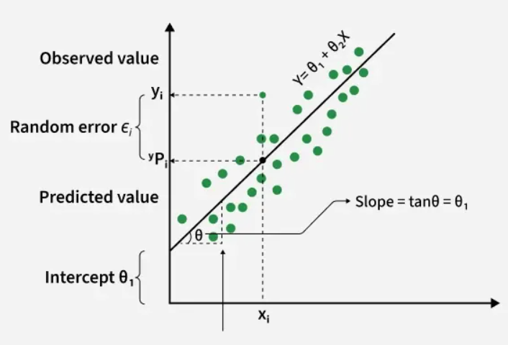

Best Fit Line in Linear Regression
$$θ_{2}$$

Slide 5
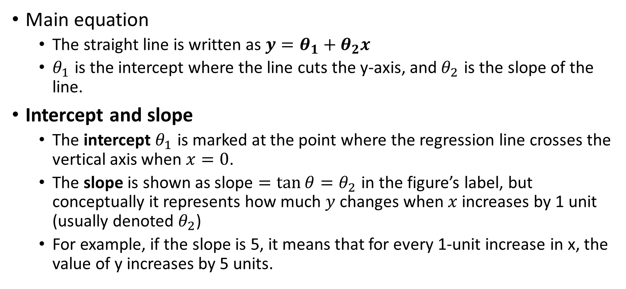
Best Fit Line in Linear Regression
Main equation
The straight line is written as $y=θ_{1}+θ_{2}x$
$θ_{1}$ is the intercept where the line cuts the y‑axis, and $θ_{2}$ is the slope of the line.
Intercept and slope
The intercept $θ_{1}$ is marked at the point where the regression line crosses the vertical axis when $x=0$.
The slope is shown as $\text{slope}=\tan{θ}=θ_{2}$ in the figure’s label, but conceptually it represents how much $y$ changes when $x$ increases by 1 unit (usually denoted $θ_{2}$)
For example, if the slope is 5, it means that for every 1-unit increase in x, the value of y increases by 5 units.

Slide 6
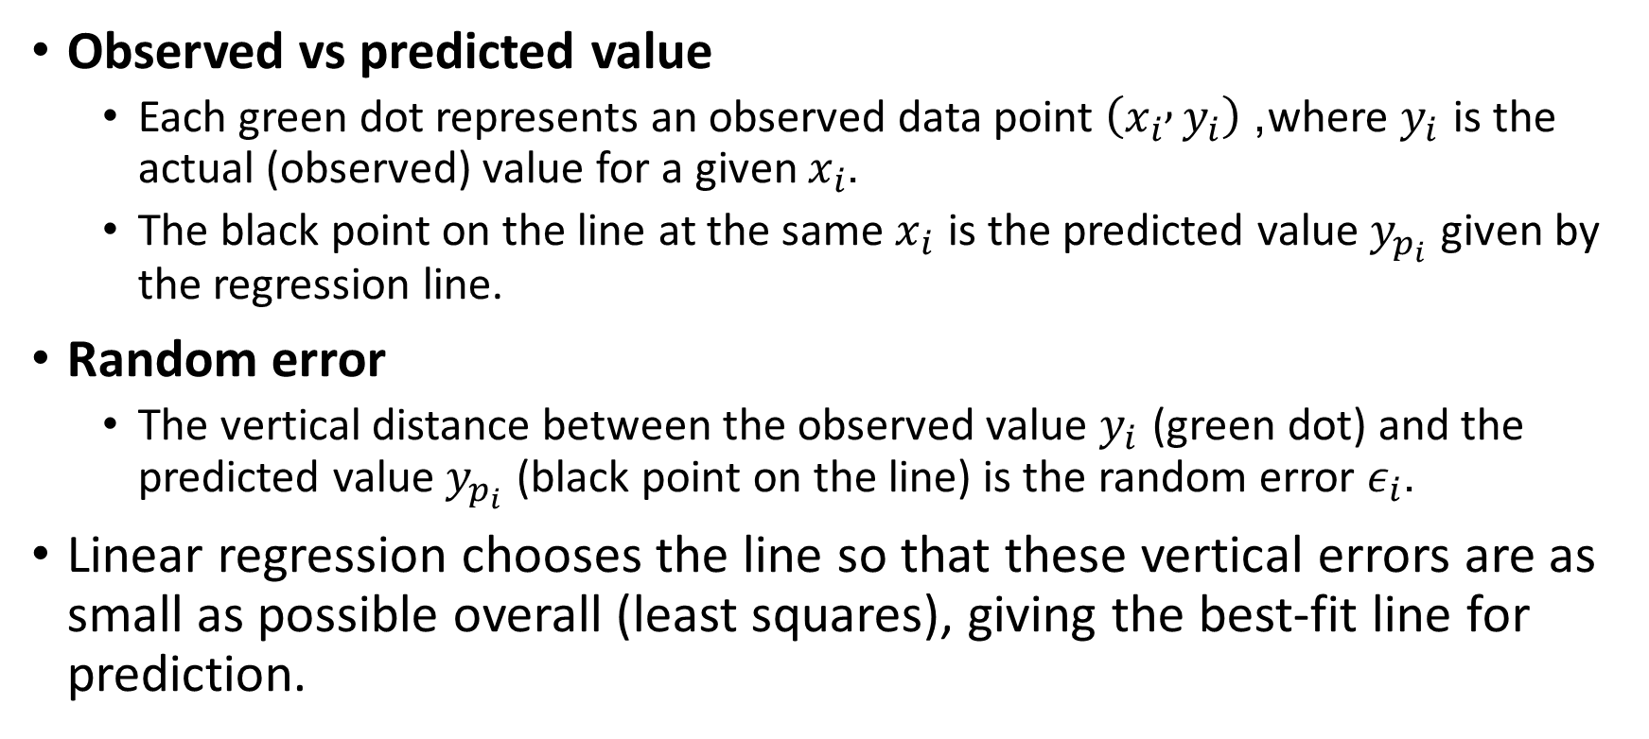
Best Fit Line in Linear Regression
Observed vs predicted value
Each green dot represents an observed data point $\left(x_{i} , y_{i}\right)$, where $y_{i}$ is the actual (observed) value for a given $x_{i}$.
The black point on the line at the same $x_{i}$ is the predicted value $y_{p_{i}}$ given by the regression line.
Random error
The vertical distance between the observed value $y_{i}$ (green dot) and the predicted value $y_{p_{i}}$ (black point on the line) is the random error $ε_{i}$.
Linear regression chooses the line so that these vertical errors are as small as possible overall (least squares), giving the best‑fit line for prediction.

Slide 7
Best Fit Line in Linear Regression
Y is called a dependent or target variable
X is called an independent variable also known as the predictor of Y.
There are many types of functions or modules that can be used for regression.
A linear function is the simplest type of function. Here, X may be a single feature or multiple features representing the problem.

Slide 8
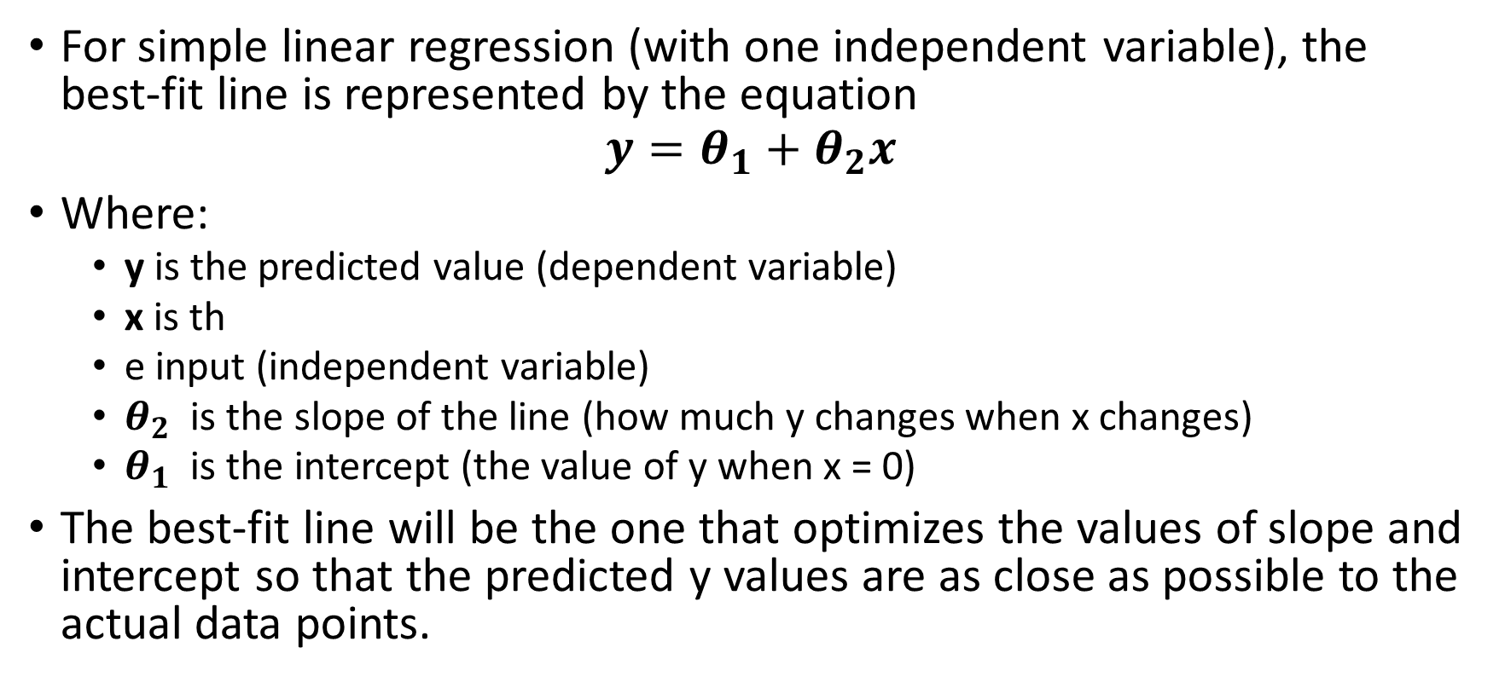
Equation of the Best-Fit Line
For simple linear regression (with one independent variable), the best-fit line is represented by the equation
$$y=θ_{1}+θ_{2}x$$
Where:
y is the predicted value (dependent variable)
x is th
e input (independent variable)
$θ_{2}$ is the slope of the line (how much y changes when x changes)
$θ_{1}$ is the intercept (the value of y when x = 0)
The best-fit line will be the one that optimizes the values of slope and intercept so that the predicted y values are as close as possible to the actual data points.

Slide 9
Assumptions of the Linear Regression
Linearity: The relationship between inputs (X) and the output (Y) is a straight line.
Independence of Errors: The errors in predictions should not affect each other.
Constant Variance (Homoscedasticity): The errors should have equal spread across all values of the input. If the spread changes (like fans out or shrinks), it's called heteroscedasticity and it's a problem for the model.
Normality of Errors: The errors should follow a normal (bell-shaped) distribution.
No Multicollinearity(for multiple regression): Input variables shouldn’t be too closely related to each other.
No Autocorrelation: Errors shouldn't show repeating patterns, especially in time-based data.
Additivity: The total effect on Y is just the sum of effects from each X, no mixing or interaction between them.

Slide 10
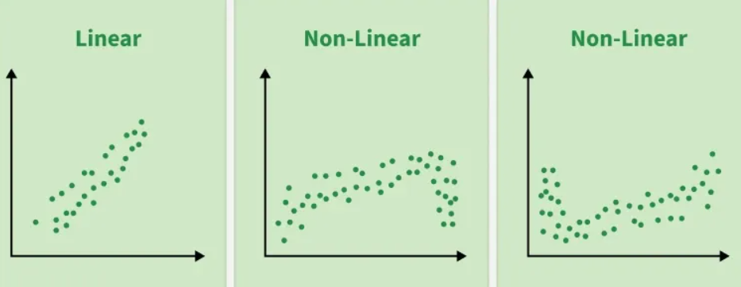
Assumptions of the Linear Regression

Slide 11
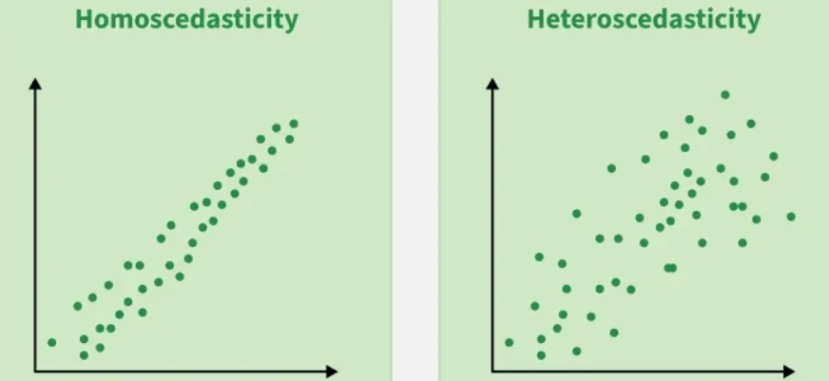
Assumptions of the Linear Regression

Slide 12
Types of Linear Regression
Simple Linear Regression
One independent variable (X) predicting one dependent variable (Y)
Multiple Linear Regression
Multiple independent variables predicting one dependent variable

Slide 13
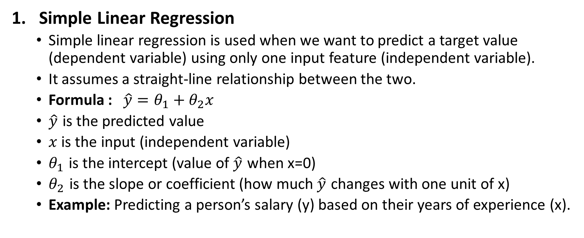
Type of Linear Regression
Simple Linear Regression
Simple linear regression is used when we want to predict a target value (dependent variable) using only one input feature (independent variable).
It assumes a straight-line relationship between the two.
Formula : $\hat{y}=θ_{1}+θ_{2}x$
$\hat{y}$​ is the predicted value
$x$ is the input (independent variable)
$θ_{1}$ is the intercept (value of $\hat{y}\text{​}$ when x=0)
$θ_{2}$​ is the slope or coefficient (how much $\hat{y}$​ changes with one unit of x)
Example: Predicting a person’s salary (y) based on their years of experience (x).

Slide 14
Type of Linear Regression
2. Multiple Linear Regression
Multiple linear regression involves more than one independent variable and one dependent variable.
A linear model makes a prediction by simply computing a weighted sum of the input features, plus a constant called the bias term (also called the intercept term)
Example : Real Estate: Predict property prices using location, size and other factors.

Slide 15
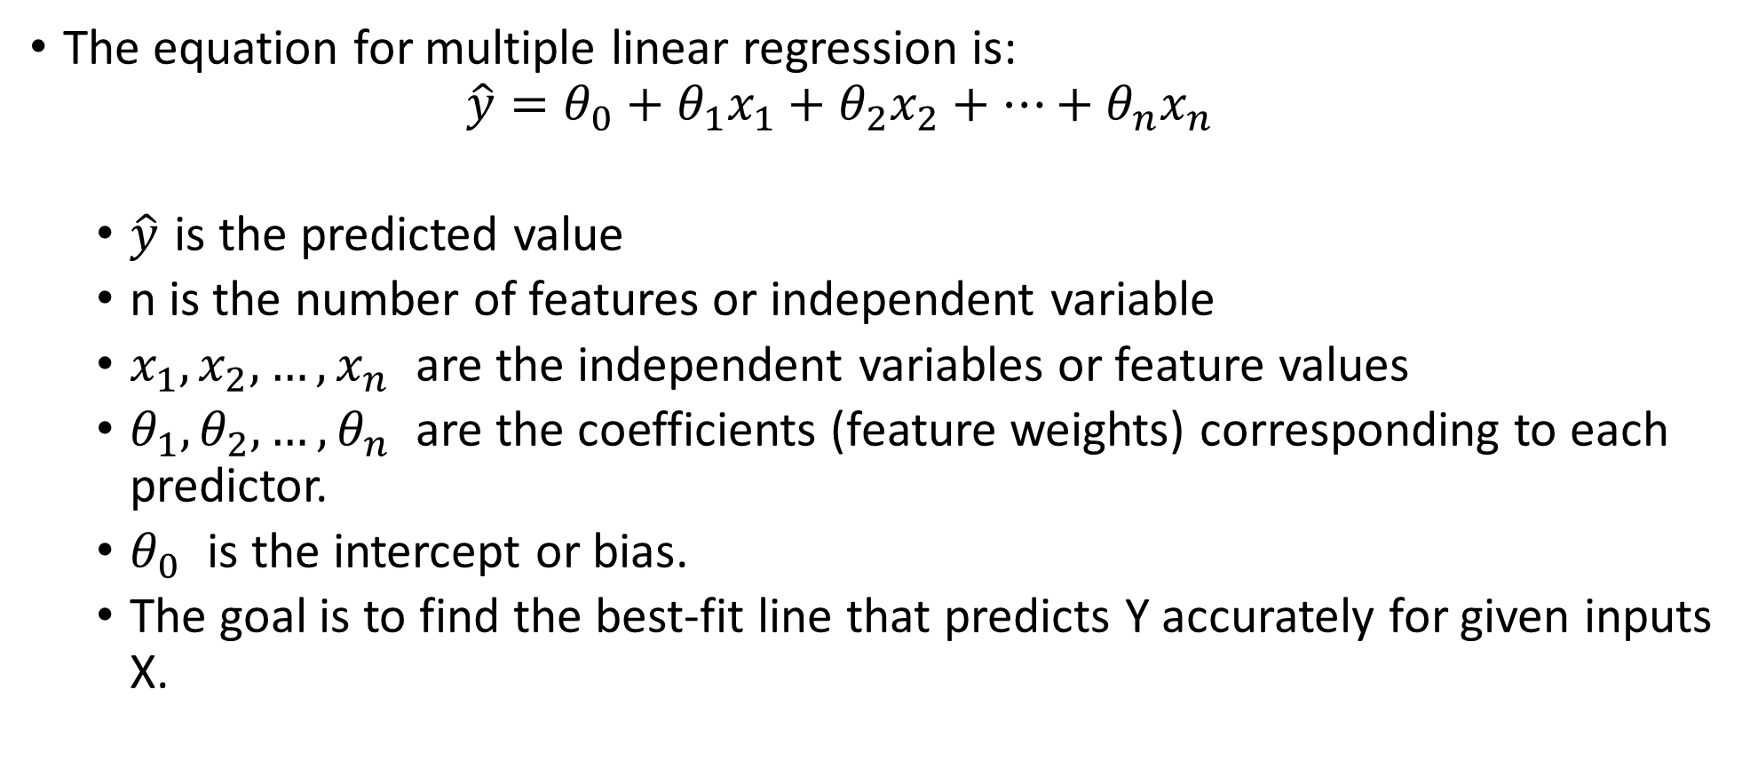
Multiple Linear Regression
The equation for multiple linear regression is:
$$\hat{y}=θ_{0}+θ_{1}x_{1}+θ_{2}x_{2}+⋯+θ_{n}x_{n}$$
$\hat{y}$​ is the predicted value
n is the number of features or independent variable
$x_{1},x_{2},…,x_{n}$ are the independent variables or feature values
$θ_{1},θ_{2},…,θ_{n}$ are the coefficients (feature weights) corresponding to each predictor.
$θ_{0}$ is the intercept or bias.
The goal is to find the best-fit line that predicts Y accurately for given inputs X.

Slide 16
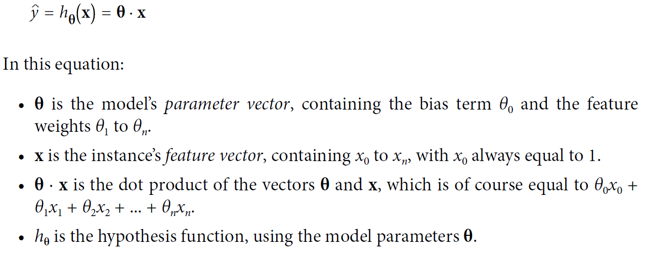
Linear Regression model prediction (vectorized form)

Slide 17
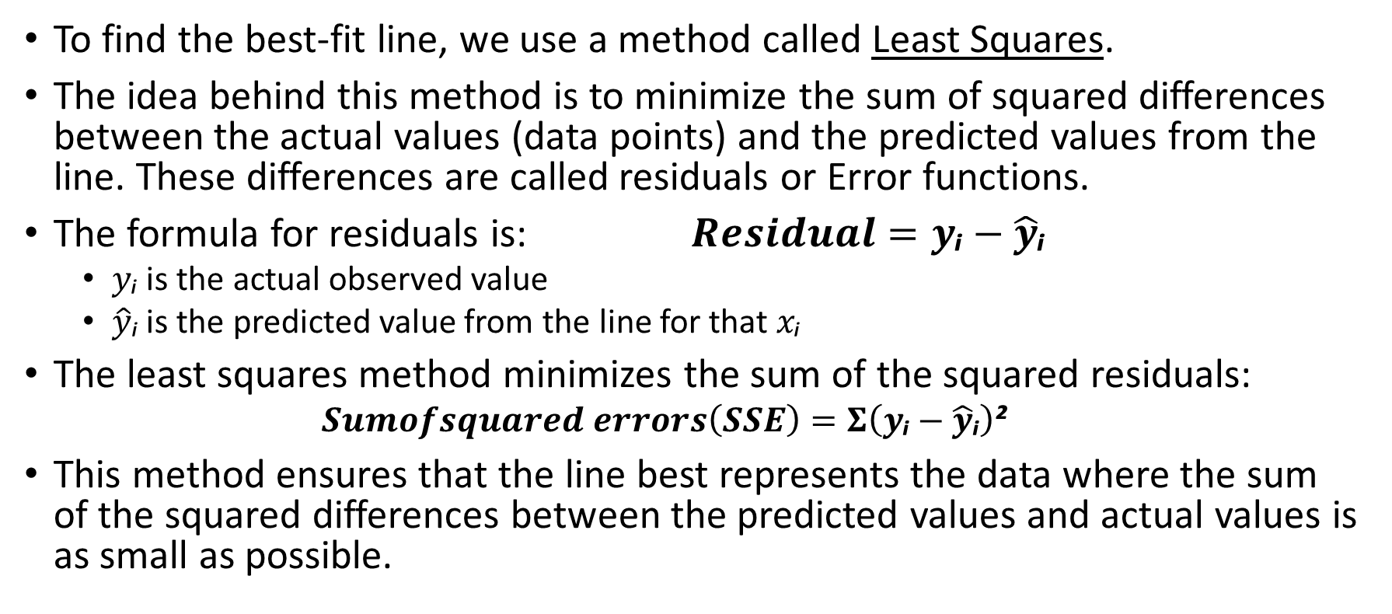
Minimizing the Error: The Least Squares Method
To find the best-fit line, we use a method called Least Squares.
The idea behind this method is to minimize the sum of squared differences between the actual values (data points) and the predicted values from the line. These differences are called residuals or Error functions.
The formula for residuals is: $Residual=y\text{ᵢ}−\hat{y}\text{ᵢ}$
$y\text{ᵢ}$ is the actual observed value
$\hat{y}\text{ᵢ}$ is the predicted value from the line for that $x\text{ᵢ}$
The least squares method minimizes the sum of the squared residuals:
$$Sumofsquared errors\left(SSE\right)=Σ\left(y\text{ᵢ}−\hat{y}\text{ᵢ}\right)\text{²}$$
This method ensures that the line best represents the data where the sum of the squared differences between the predicted values and actual values is as small as possible.

Slide 18
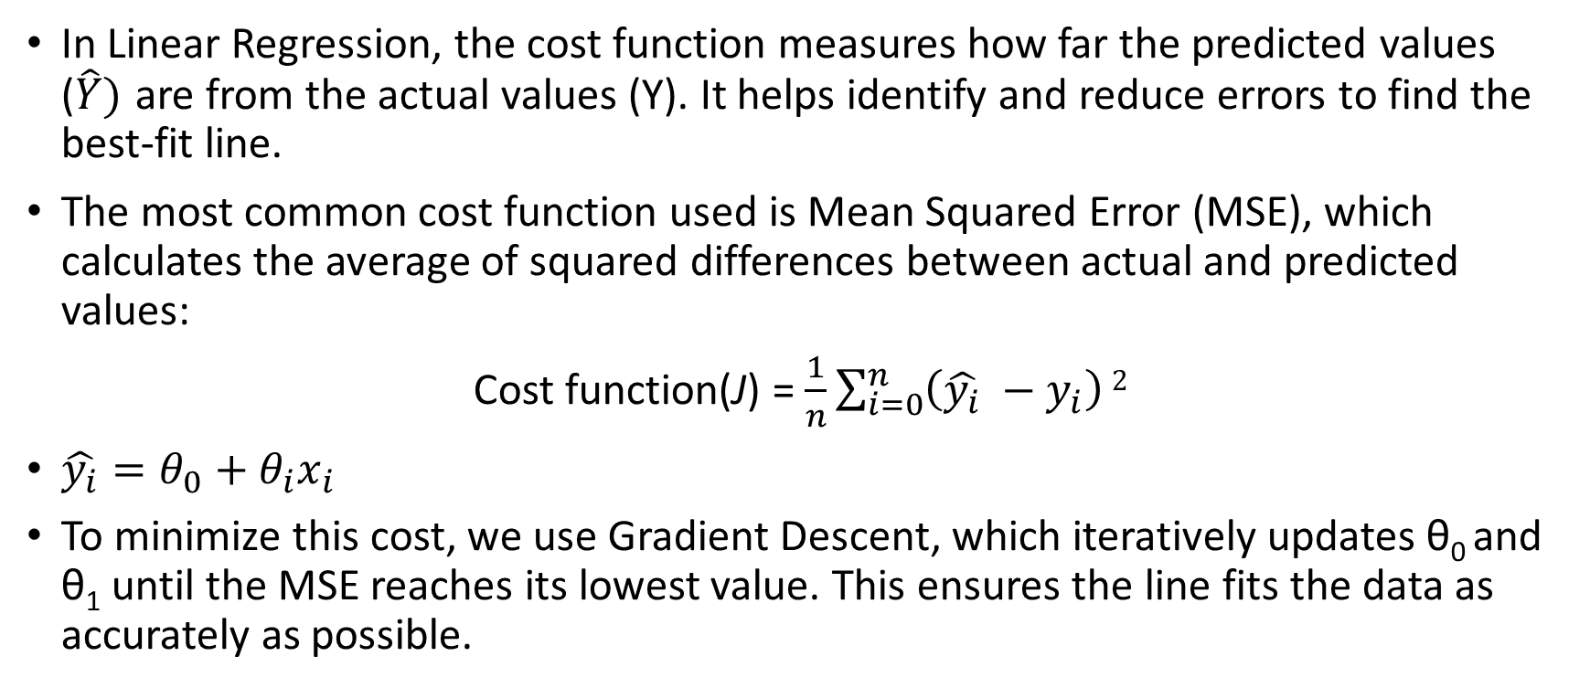
Cost function for Linear Regression
In Linear Regression, the cost function measures how far the predicted values ($\hat{Y})$ are from the actual values (Y). It helps identify and reduce errors to find the best-fit line.
The most common cost function used is Mean Squared Error (MSE), which calculates the average of squared differences between actual and predicted values:
Cost function(J) = $\frac{1}{n}\sum_{i=0}^{n}{\left(\hat{y_{i}} −y_{i}\right)}2$
$\hat{y_{i}}=θ_{0}+θ_{i}x_{i}$
To minimize this cost, we use Gradient Descent, which iteratively updates θ₀ and θ₁ until the MSE reaches its lowest value. This ensures the line fits the data as accurately as possible.

Slide 19
Evaluation Metrics for Linear Regression
A variety of evaluation measures can be used to determine the strength of any linear regression model. These assessment metrics often give an indication of how well the model is producing the observed outputs.
The most common measurements are:
Mean Square Error (MSE)
Mean Absolute Error (MAE)
Root Mean Squared Error (RMSE)

Slide 20
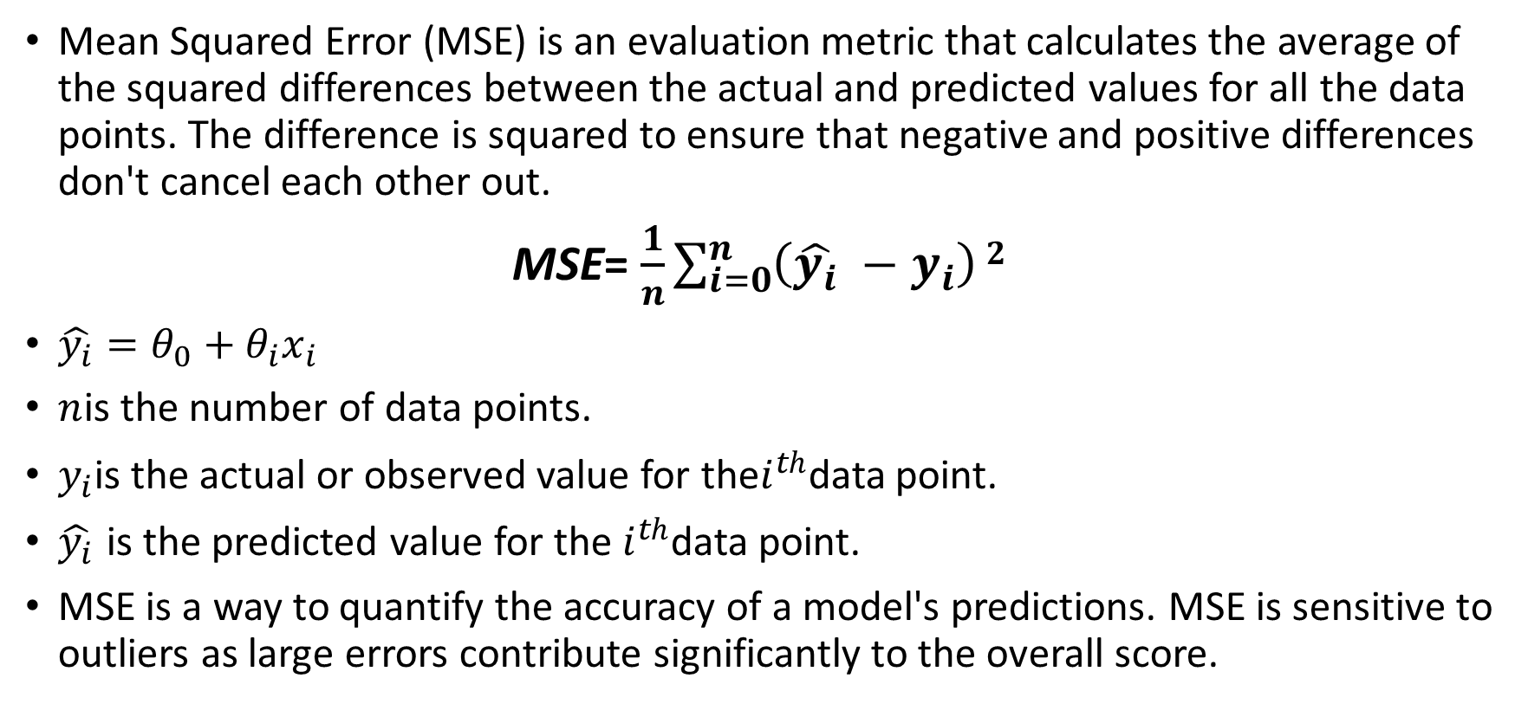
1. Mean Square Error (MSE)
Mean Squared Error (MSE) is an evaluation metric that calculates the average of the squared differences between the actual and predicted values for all the data points. The difference is squared to ensure that negative and positive differences don't cancel each other out.
MSE= $\frac{1}{n}\sum_{i=0}^{n}{\left(\hat{y_{i}} −y_{i}\right)}2$
$\hat{y_{i}}=θ_{0}+θ_{i}x_{i}$
$n$is the number of data points.
$y_{i}$is the actual or observed value for the$i^{th}$data point.
$\hat{y_{i}}$ is the predicted value for the $i^{th}$data point.
MSE is a way to quantify the accuracy of a model's predictions. MSE is sensitive to outliers as large errors contribute significantly to the overall score.

Slide 21
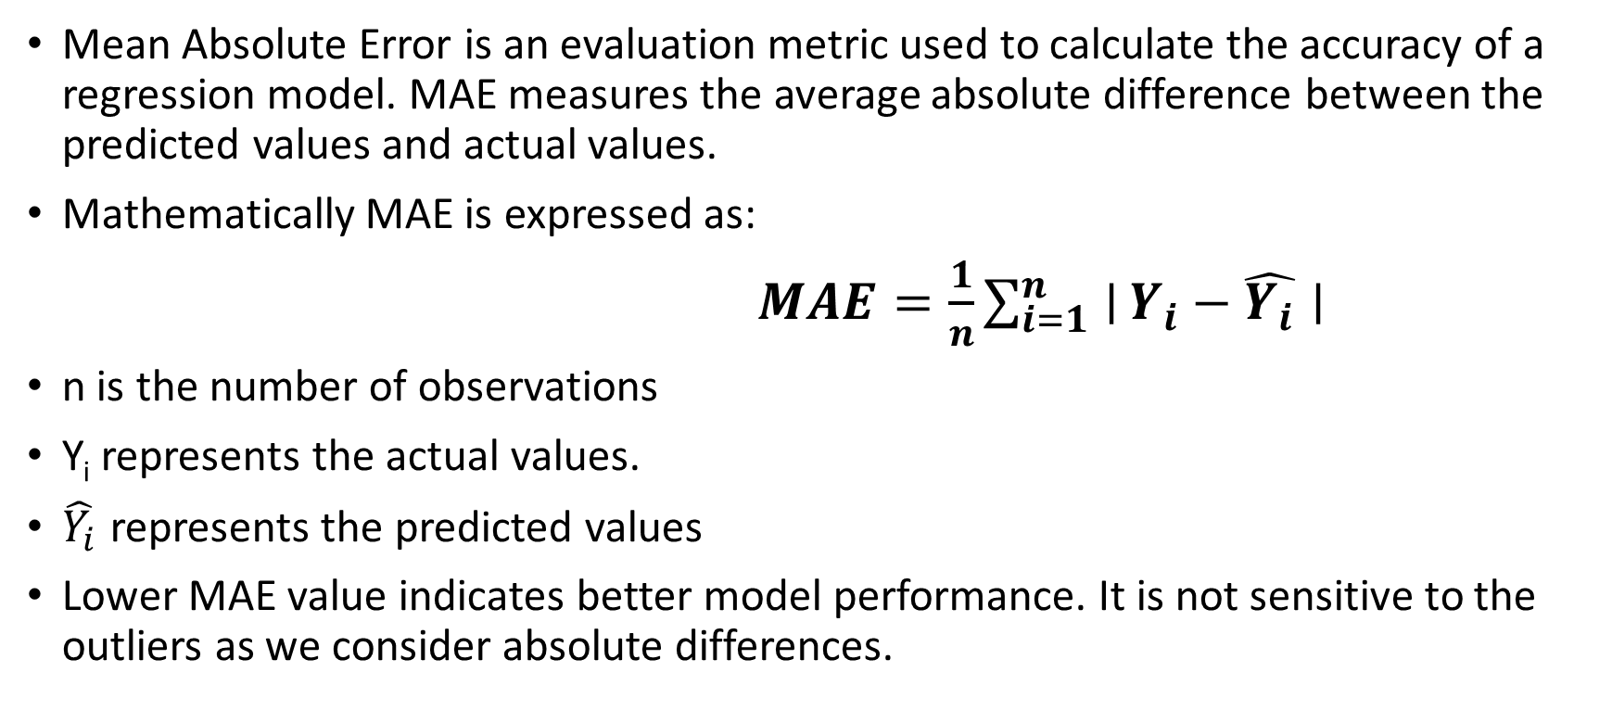
2. Mean Absolute Error (MAE)
Mean Absolute Error is an evaluation metric used to calculate the accuracy of a regression model. MAE measures the average absolute difference between the predicted values and actual values.
Mathematically MAE is expressed as:
$MAE=\frac{1}{n}\sum_{i=1}^{n}{∣}Y_{i}−\hat{Y_{i}}∣$
n is the number of observations
Y_{i} represents the actual values.
$\hat{Y_{i}}$ represents the predicted values
Lower MAE value indicates better model performance. It is not sensitive to the outliers as we consider absolute differences.

Slide 22
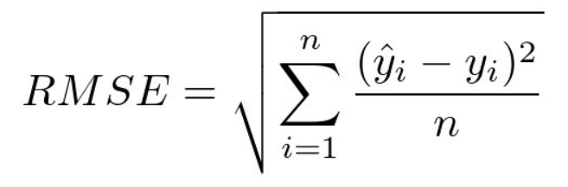
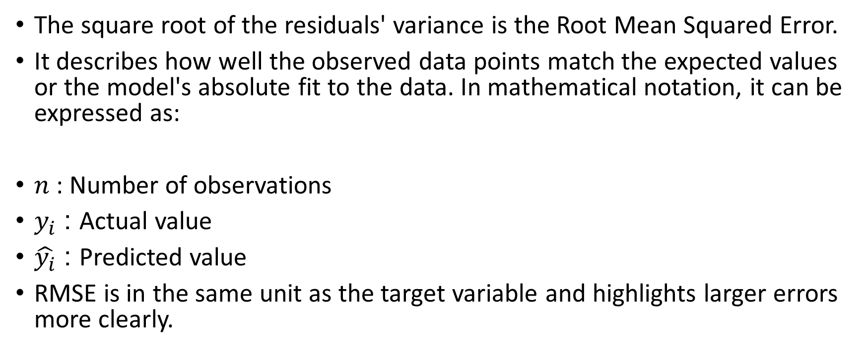
3.Root Mean Squared Error (RMSE)
The square root of the residuals' variance is the Root Mean Squared Error.
It describes how well the observed data points match the expected values or the model's absolute fit to the data. In mathematical notation, it can be expressed as:
$n$ : Number of observations
$y_{i}$ : Actual value
$\hat{y_{i}}$​ : Predicted value
RMSE is in the same unit as the target variable and highlights larger errors more clearly.

Slide 23
Why Linear Regression is Important
Here’s why linear regression is important:
Simplicity and Interpretability: It’s easy to understand and interpret, making it a starting point for learning about machine learning.
Predictive Ability: Helps predict future outcomes based on past data, making it useful in various fields like finance, healthcare and marketing.
Basis for Other Models: Many advanced algorithms, like logistic regression or neural networks, build on the concepts of linear regression.
Efficiency: It’s computationally efficient and works well for problems with a linear relationship.
Widely Used: It’s one of the most widely used techniques in both statistics and machine learning for regression tasks.
Analysis: It provides insights into relationships between variables (e.g., how much one variable influences another).

Slide 24
Advantages of Linear Regression
Linear regression is a relatively simple algorithm, making it easy to understand and implement. The coefficients of the linear regression model can be interpreted as the change in the dependent variable for a one-unit change in the independent variable, providing insights into the relationships between variables.
Linear regression is computationally efficient and can handle large datasets effectively. It can be trained quickly on large datasets, making it suitable for real-time applications.
Linear regression is relatively robust to outliers compared to other machine learning algorithms. Outliers may have a smaller impact on the overall model performance.
Linear regression often serves as a good baseline model for comparison with more complex machine learning algorithms.
Linear regression is a well-established algorithm with a rich history and is widely available in various machine learning libraries and software packages.

Slide 25
Limitations of Linear Regression
Linear regression assumes a linear relationship between the dependent and independent variables. If the relationship is not linear, the model may not perform well.
Linear regression is sensitive to multicollinearity, which occurs when there is a high correlation between independent variables. Multicollinearity can inflate the variance of the coefficients and lead to unstable model predictions.
Linear regression assumes that the features are already in a suitable form for the model. Feature engineering may be required to transform features into a format that can be effectively used by the model.
Linear regression is susceptible to both overfitting and underfitting. Overfitting occurs when the model learns the training data too well and fails to generalize to unseen data. Underfitting occurs when the model is too simple to capture the underlying relationships in the data.
Linear regression provides limited explanatory power for complex relationships between variables. More advanced machine learning techniques may be necessary for deeper insights.

Slide 26
Applications & Use Cases
Predictive modeling (sales forecasting, price prediction)
Risk assessment and factor analysis in finance
Trend analysis and time-series forecasting
Feature importance and relationship analysis

Slide 27
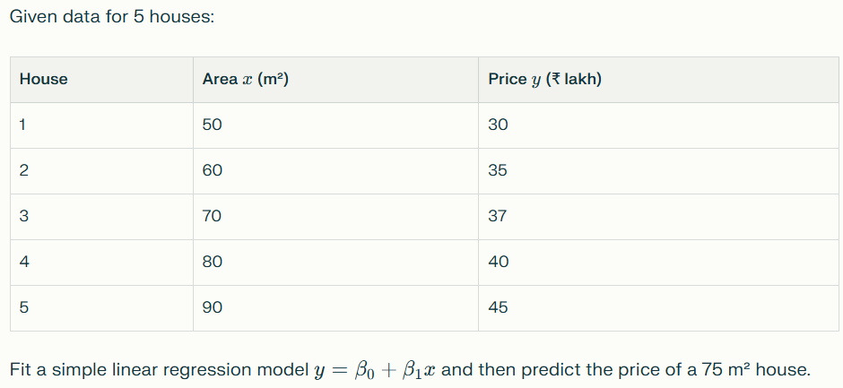
Linear Regression Problem

Slide 28
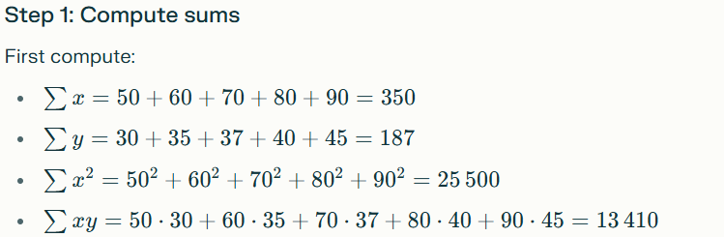
Linear Regression Problem

Slide 29
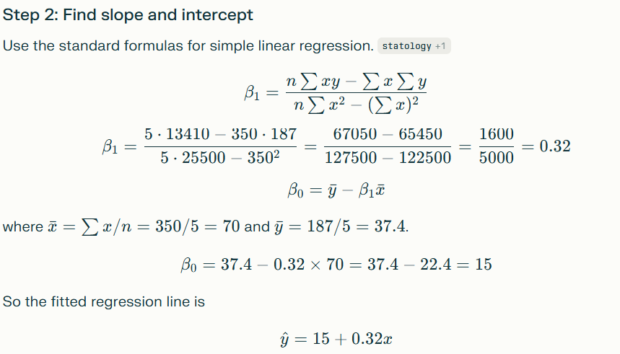

Slide 30
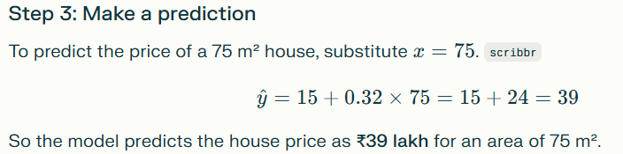

Slide 31
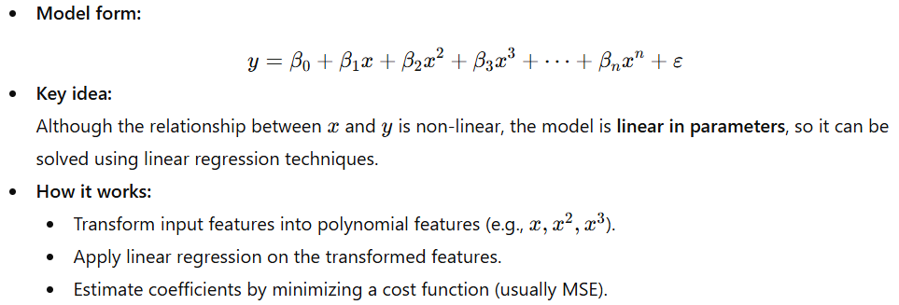
Polynomial Regression
Polynomial Regression is a type of regression model that captures a non-linear relationship between the independent variable(s) and the dependent variable by fitting a polynomial equation to the data.

Slide 32
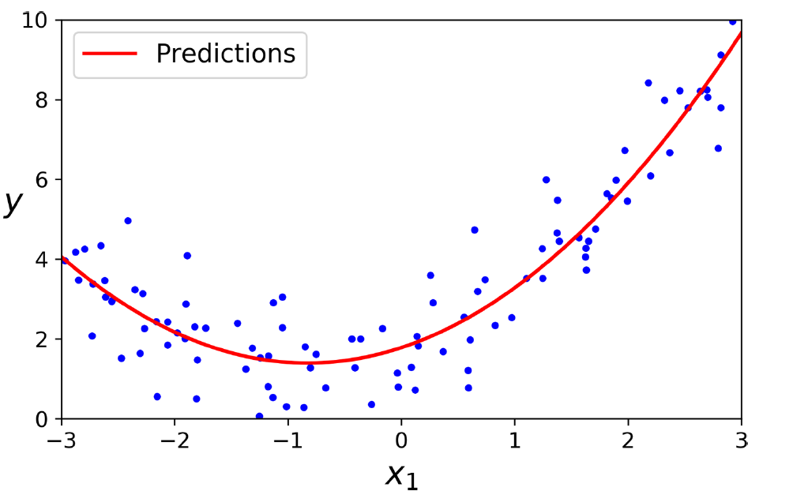
Polynomial Regression

Slide 33
Polynomial Regression
Advantages:
Models complex, curved trends in data.
More flexible than simple linear regression.
Easy to implement.
Disadvantages:
High-degree polynomials can cause overfitting.
Poor extrapolation outside the data range.
Sensitive to outliers.

Slide 34
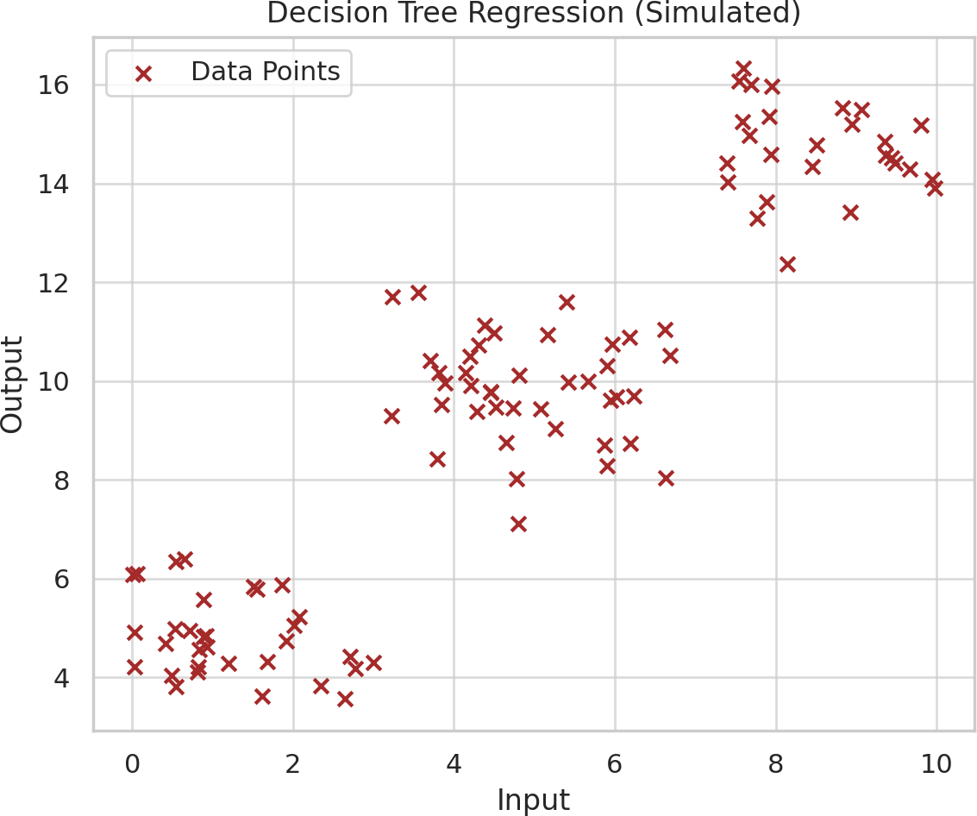
Decision Tree Regression
Breaks data into branches based on feature conditions (like a flowchart). Each branch leads to a predicted output value.
When to Use:
When the data has sudden jumps or clear thresholds. Handles both linear and non-linear data.
Example:
Predicting electricity usage:
If temperature < 20°C → Low usage If 20–30°C → Medium usage
If >30°C → High usage

Slide 35
Regression Type | Shape of Model | Handles Multiple Inputs? | Suitable For
Linear Regression | Straight Line | + No | Simple linear trends
Multiple Linear Regression | Straight Plane | ⬛ Yes | Multi-factor predictions
Polynomial Regression | Curved Line | ⬛ Yes | Non-linear trends
Decision Tree Regression | Step-wise | ⬛ Yes | Rule-based or piecewise data patterns

